Slide 1

Fashion Intelligence Systems
Team Name : The Ignitors
Institute Name: NIT Rourkela

Slide 2

Team members details
Team Name | The Ignitors
Institute Name | National Institute of Technology, Rourkela
Team Members > | 1 (Leader) | 2 | 3
Name | Biswajit Nayak | Debabrata Panigrahi | Pritish Kar
Batch | 2017-2021 | 2018-2022 | 2017-2021

Slide 3
Glossary
gRPC - gRPC (gRPC Remote Procedure Calls) is an open source remote procedure call (RPC) system initially developed at Google in 2015.
DB - Database

Slide 4





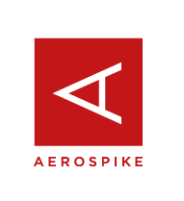

Use-cases
identify trending fashion products
Ranking the products based on
various parameters
Ecommerce
sites
Dashboard display for designers/ retailers
blogs/magazines
Ensuring quicker response to
request
Getting Rid of outdated styles from DB.
through a multiprocessing
server
Designer/Retailer
database
Outdated fashion trends

Slide 5
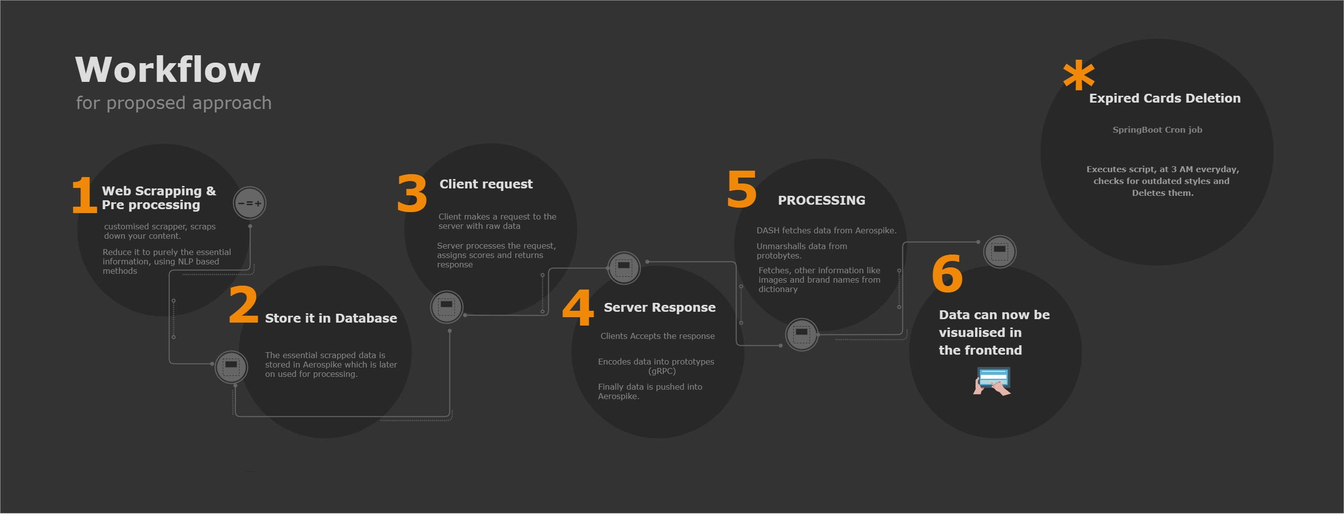

Slide 6
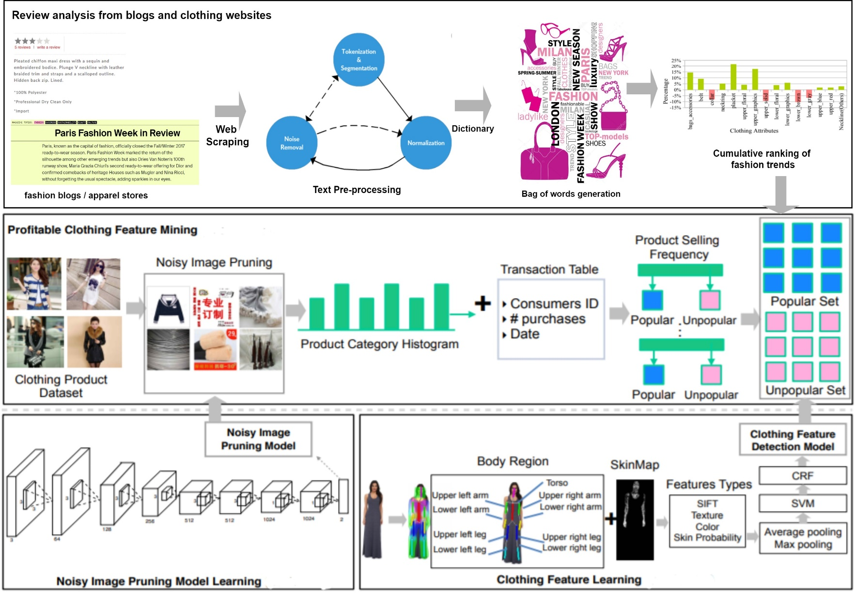
Scoring/Ranking Algorithm

Slide 7
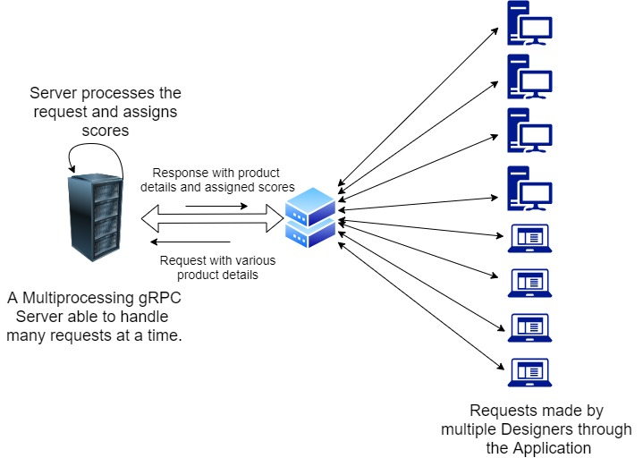
Handling Client Requests & Processing
Important:-
Link to Detailed Workflow/UI & Experimentations performed:-
FlipKart_Grid_extras

Slide 8
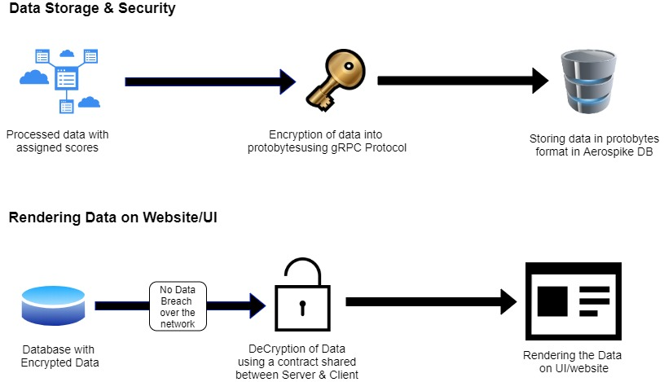
Data Storage, Security & Rendering

Slide 9
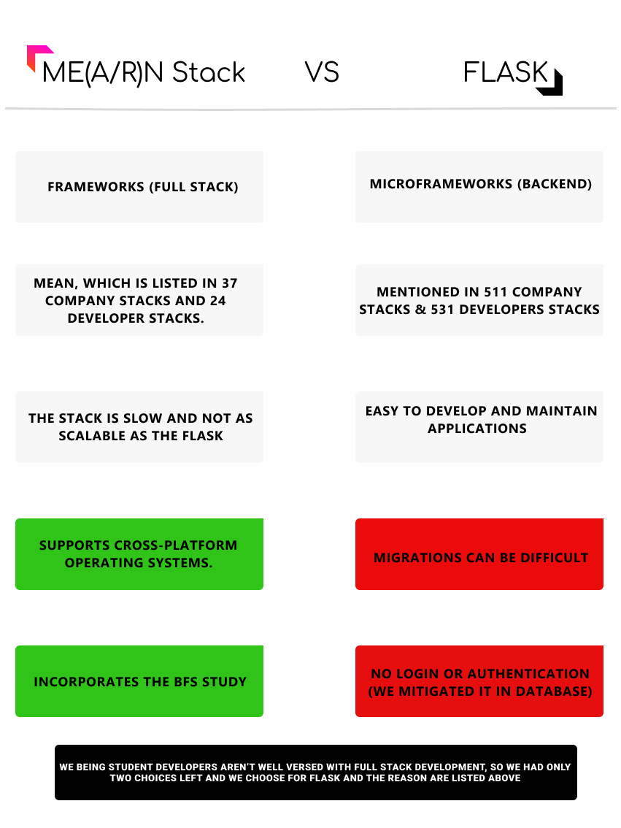
Tech Stack Preference
ME(A/R)N Stack V/s FLASK

Slide 10
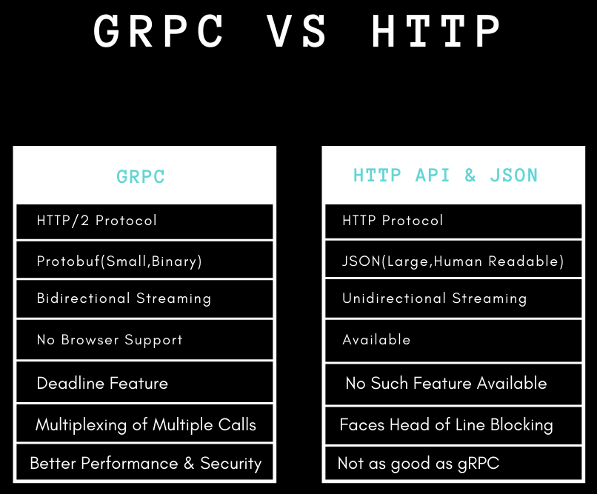
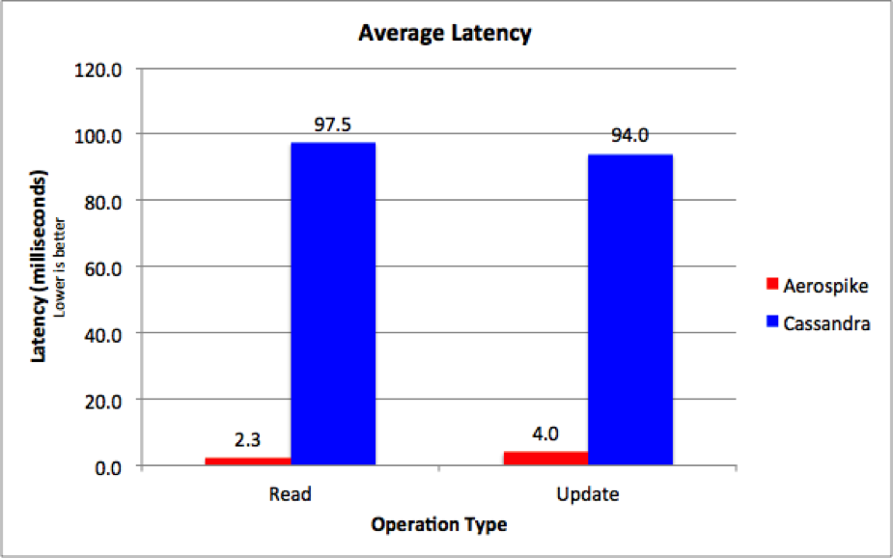
Database & Protocol Preference
Aerospike(Used By Flipkart) vs Cassandra
Aerospike vs No-SQL DB:-
Aerospike vs ScyllaDB
Best No-SQL Standouts
Aerospike vs Cassandra
gRPC vs HTTP:-
Microsoft Docs - gRPC vs HTTP

Slide 11
Limitations
For credibility and changing trends, we have to validate the application through designers. So, for this we have also thought of accommodating some extra parameters which would be taken as input from designers and used for training a Machine Learning Model.

Slide 12

Future Scope
The Application Developed will be completely scalable, integrated with Aerospike Database(Hybrid Architecture) used by Flipkart.
Easy to use application, can handle multiple requests made by different designers through the multiprocessing gRPC server.
New Styles are added and old ones are deleted constantly over a period of time, so that designers have a proper access to the most trending styles in the market.
Faster network transmission & higher level of added security on replacing HTTP protocol by gRPC.

Slide 13
